Slide 1

Ioa Bone & Joint week 2025
3rd to 10th August 2025
Presidential Theme
"Old is Gold : 360° Care for the Elderly”
Ensuring Mobility, Dignity, and Longevity

Slide 2
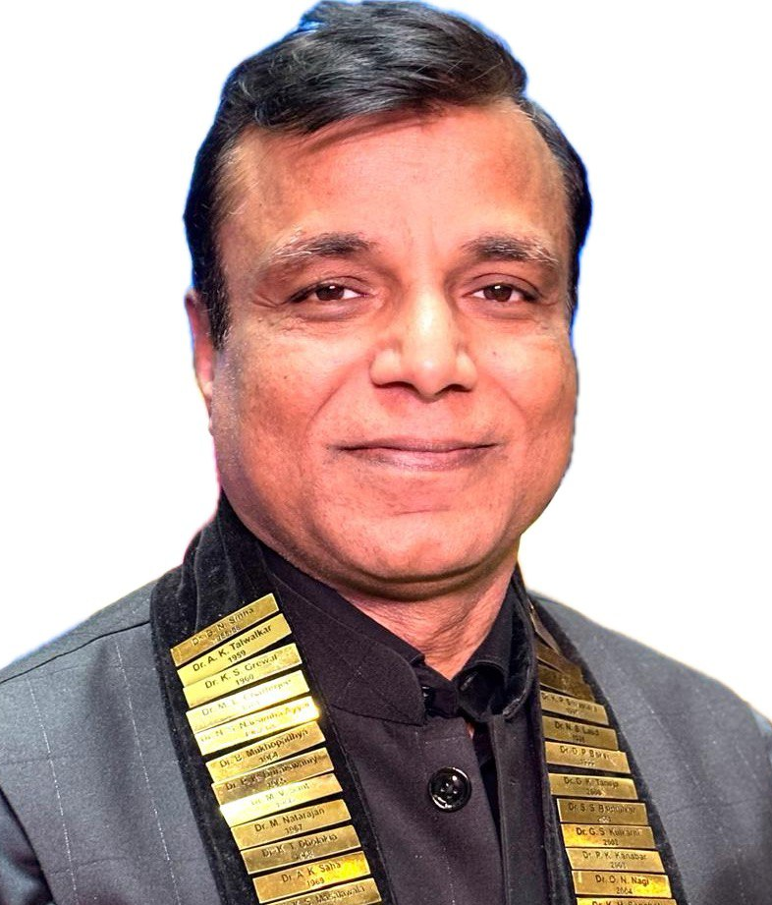
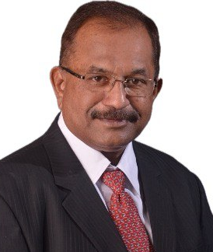
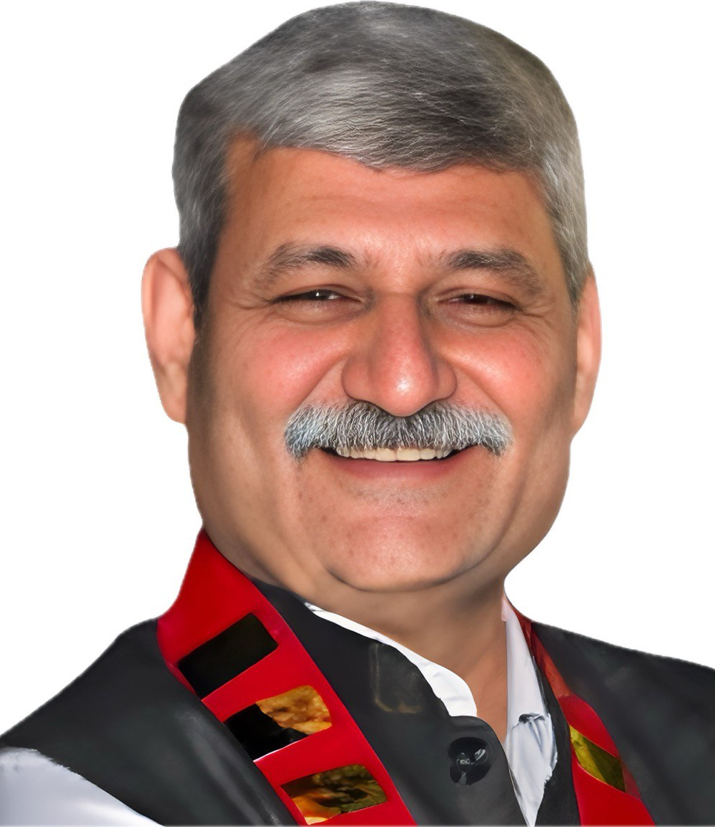
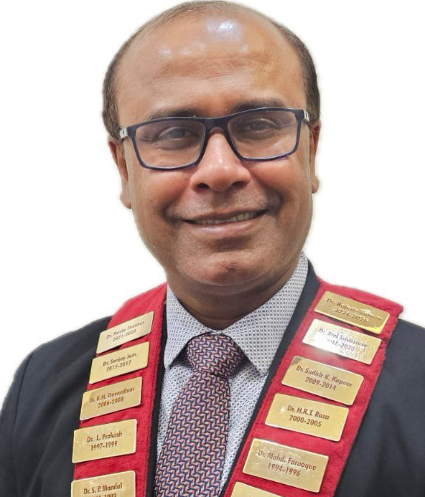
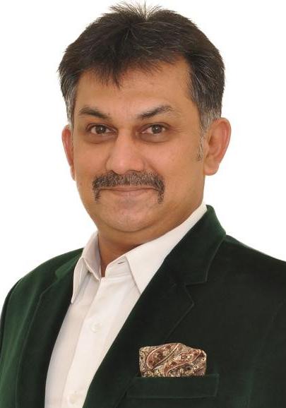
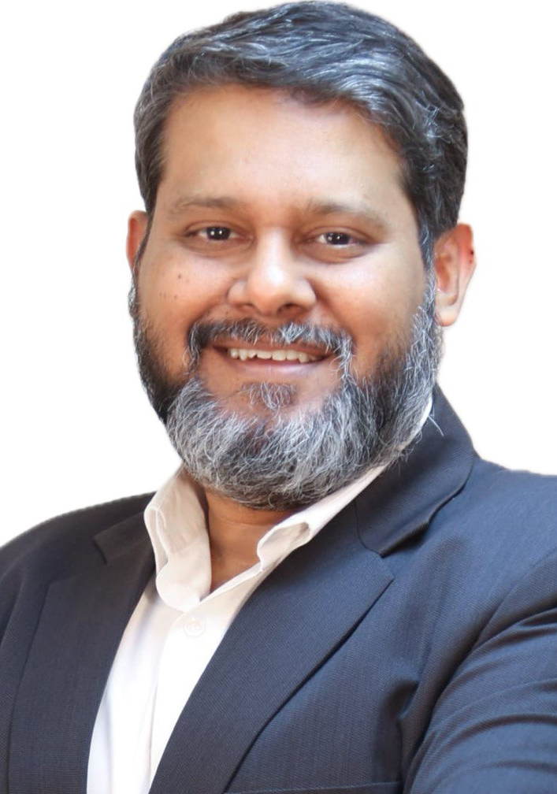
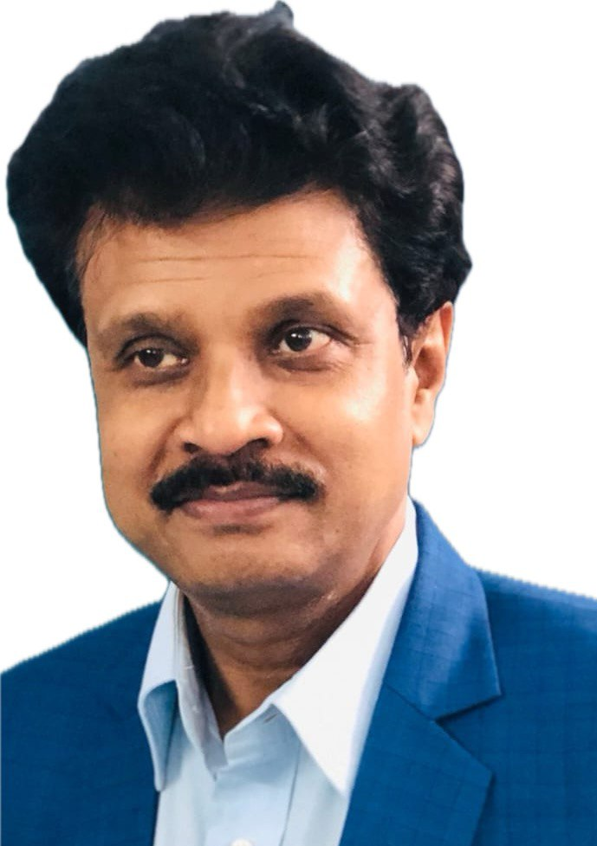
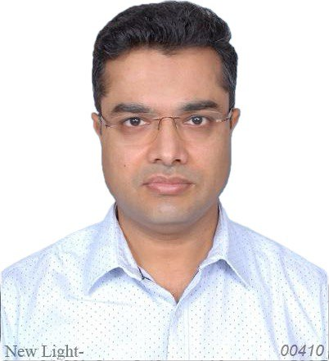
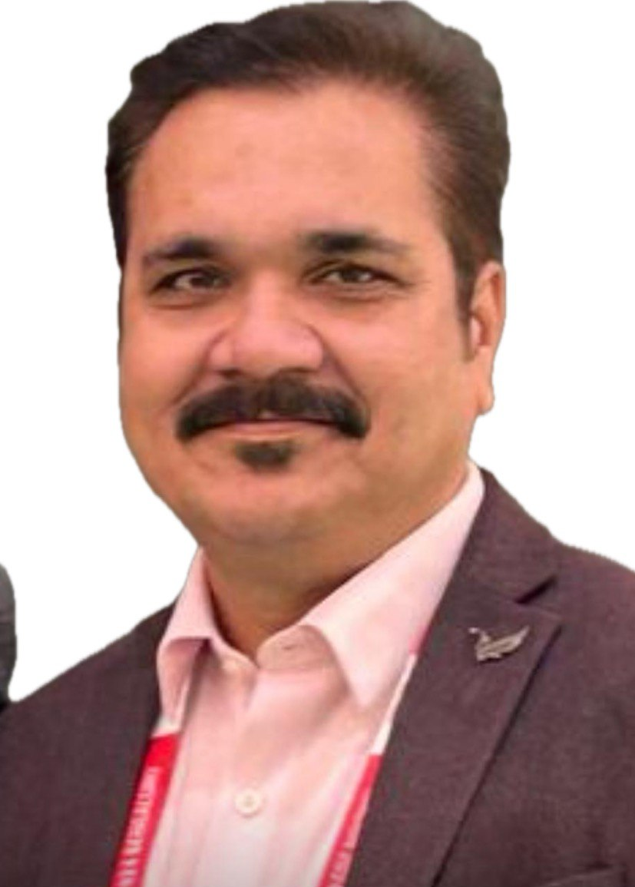
Team IOA CSRC 2025
Dr. Anup Agrawal
President IOA
Dr. Ajit Shinde
President IOA
Dr. Navin Thakkar
President Elect IOA
Dr. Rajeev Raman
Secretary General IOA
Dr. Bharath Raju G.
CSRC
Dr. Abhijeet Wahegaokar CSRC
Dr. Gaur Gautam Kar
CSRC
Dr. Puneet Agrawal CSRC
Dr. Rajveer S. Bajoria
CSRC

Slide 3
Bone & Joint Week 2025 3rd August - 10th August Bone & Joint Day 2025 4th August

Slide 4
Presidential Theme
"Old is Gold : 360° Care for the Elderly”
Ensuring Mobility, Dignity, and Longevity

Slide 5
Bone & Joint Week 2025
1. IOA ELDERLY CARE CLINIC:
To start:
A special subsidized OPD dedicated to elderly
Once a week or fortnight
Physiotherapy Sessions
Subsidized Diagnostics
Subsidized Medicines & Medical Assistive Devices

Slide 6
Bone & Joint Week 2025
2. Awareness Programs:
Elderly bone health
Arthritis
Fall prevention
Mental health
Through Rallies, Pamphlets, Banners, Hoardings, TV Shows
Public Seminars & Engaging Sessions with Morning Walkers, Old Age Homes, Residential Societies

Slide 7
Bone & Joint Week 2025
3. Camps:
General checkup
Mental checkup
BMD
Fall Prevention

Slide 8
Bone & Joint Week 2025
4. IOA Golden Achiever Awards:
Give this in every camp & programs to elderly -
Who have overcome Orthopaedic disability
Actively engaged in any social activities

Slide 9
Bone & Joint Week 2025
5. Geriatric Fractures CME - Management & Prevention
6. Old Age Home visits
7. Educational Video & Digital Message - on Do’s and Dont’s
8. Handbook: Orthocare for Elderly (in all regional language)
9. Special Issue in IOA Journal

Slide 10
Bone & Joint Week 2025
10. Special Prize for three Best Innovation/Research Papers on Elderly Care
11. Media Coverage
12. Engagement with Government
Submit White Paper on improving Orthopaedic Health of Indian Elderly
Insurance
Mandatory osteoporosis Screening after 60

Slide 11
Bone & Joint Week 2025
Awareness - 360° Care for the Elderly
Print & Electronic Media - Hold press conference
Print & Electronic Media - Make them strategic partner
Social Media - Facebook, WhatsApp, Instagram
Banners /Posters /Pamphlets
Students – art competitions /Quiz
(Content would be provided by IOA & can also be prepared by the State, the same can be translated into local language)

Slide 12
Bone & Joint Week 2025
State Chapter Award
Bone and Joint Day Activities | 50
Theme Based Activity | 30
Social Activity / Public Awareness Activity | 5
Media Coverage – Print / Electronic / Social | 10
Any other unique program related to the Theme | 5

Slide 13
Bone & Joint Week 2025
1 | Theme Based Activity |  | Max. Marks- 25 | State Marks
1. A | IOA Elderly Clinic in OPD | 1 Mark per Clinic
2 | Extra Marks for Theme Based Activity |  | Max. Marks - 5
2.A | For Old Age Home Visits | 0.5 Marks /Visit | 2
2.B | Geriatric Fractures CME | 0.5 Marks /CME | 2
2.C | Camps | 0.25 Marks /Camp | 1
3 | Each Social / Public Awareness Activity apart from Elderly Care | 0.5 Marks for each activity | Max. Marks - 5
3.A | Lecture on Fall Prevention | 0.5 Mark / Lecture
3.B | Online Training Only (with more than 50 participants in session) | 0.5 Mark / Session
4 | Media coverage |  | Max. Marks - 10
4.A | Print Media | 2 Marks
4.B | Print Media (Local Language) | 1Mark
4.B | Electronic Media
 | National Channel | 2 Marks
 | Local Channel | 2 Marks
4.C | Social Media
 | Facebook | 1 Mark
 | WhatsApp | 1 Mark
 | Instagram | 1 Mark
5 | Any other unique activity related to theme | 0.5 Marks for each unique activity | Max. Marks - 5
 | TOTAL MARKS |  | 50
State Chapter Award Marking criteria

Slide 14
Bone & Joint Week 2025
State Chapter Award SCORING
Instructions:
The State Secretaries are requested to submit the completed Bone and Joint Week Scoring Sheet.
Please send proof of all activities as attachments marked as 1A., 2.A, or 3.A and so on in PDF format along with the Scoring Sheet.
The documents to be mailed to chairman.csrcioa@gmail.com.
Last Date to send the completed Scoring Sheet 10th of September 2025.
NOTE: IN CASE OF TIE, the following criteria would be adopted:
If number of clinics started is more than 2.5% of the State IOA Members Membership Strength the state will get 25 marks.
If less than 2.5% then the marks would be adjusted accordingly.
The IOA Elderly Care Clinic information to be uploaded via the Google Form by the members.
The same to be complied and corroborated in the Scoring Sheet.

Slide 15
Bone & Joint Week 2025
State Chapter Award
Appreciation Certificate
Two for each category: Small, Medium and Large State Chapters
Total of 6 Appreciation Certificates
First - President Appreciation Certificate
Second - Secretary Appreciation Certificate

Slide 16
IOA Zones
Zone 1: Jharkhand, North Eastern States, Orissa, West Bengal
Zone 2: Andhra Pradesh, Goa, Gujarat, Maharashtra, Telangana
Zone 3: Delhi, HP, J&K, Punjab, Rajasthan, Uttarakhand
Zone 4: Bihar, Chhattisgarh, Madhya Pradesh, Uttar Pradesh
Zone 5: Karnataka, Kerala, Puducherry, Tamil Nadu

Slide 17
Csrc Zonal coordinators
Zone 1: Jharkhand, North Eastern States, Orissa, West Bengal
Dr. Gaur Gautam Kar
9830033580

Slide 18
Csrc Zonal coordinators
Zone 2: Andhra Pradesh, Goa, Gujarat, Maharashtra, Telangana
Dr. Abhijeet Wahegaonkar
7774034263

Slide 19
Csrc Zonal coordinators
Zone 3: Delhi, Himachal Pradesh, Jammu & Kashmir, Punjab, Rajasthan, Uttarakhand
Dr. Puneet Agrawal
9837155465

Slide 20
Csrc Zonal coordinators
Zone 4: Bihar, Chhattisgarh, Madhya Pradesh, Uttar Pradesh
Dr. Rajveer S. Bajoria
9425341104

Slide 21
Csrc Zonal coordinators
Zone 5: Karnataka, Kerala, Puducherry, Tamil Nadu
Dr. Bharath Raju G.
9945982729
chairman.csrcioa@gmail.com

Slide 22
Team Ioa CSRC 2025

