Slide 1

Ioa Bone & Joint week 2025
3rd to 10th August 2025
Presidential Theme
"Old is Gold : 360° Care for the Elderly”
- Ensuring Mobility, Dignity, and Longevity

Slide 2







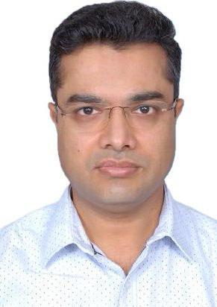

Team IOA CSRC 2025
Dr. Anup Agrawal
President IOA
Dr. Ajit Shinde
President IOA
Dr. Navin Thakkar
President Elect IOA
Dr. Rajeev Raman
Secretary General IOA
Dr. Bharath Raju G.
CSRC
Dr. Abhijeet Wahegaonkar CSRC
Dr. Gaur Gautam Kar
CSRC
Dr. Puneet Agrawal CSRC
Dr. Rajveer S. Bajoria
CSRC

Slide 3
Initiative of IOA CSRC 2025
STATE LOGO
DISTRICT
LOGO
Dr.
President State
Dr.
President District
Dr.
Secretary State
Dr.
Secretary District

Slide 4
Bone & Joint Week 2025 3rd August - 10th August
Bone & Joint Day 2025
4th August
STATE LOGO
DISTRICT
LOGO

Slide 5

Fall Prevention
STATE LOGO
DISTRICT
LOGO

Slide 6

6 Things You Can Do Today to Prevent a Fall
STATE LOGO
DISTRICT
LOGO

Slide 7
6 Things You Can Do Today to Prevent a Fall
STATE LOGO
DISTRICT
LOGO
Every 11 seconds, an older adult is seen in an emergency department for a fall-related injury. Many falls are preventable.
Prevent falls with these easy tips!

Slide 8
6 Things You Can Do Today to Prevent a Fall
STATE LOGO
DISTRICT
LOGO
Find a Balance and Exercise Program
Talk to Your Family and Friends
Talk to Your Doctor About Falls

Slide 9
6 Things You Can Do Today to Prevent a Fall
STATE LOGO
DISTRICT
LOGO
4. Review Medications with Your Doctor or Pharmacist
5. Take Care of Your Vision and Hearing
6. Make Your Home Safer

Slide 10

Find a Balance and Exercise Program
STATE LOGO
DISTRICT
LOGO

Slide 11
Find a Balance and Exercise Program
STATE LOGO
DISTRICT
LOGO
As we age, it is common to feel unsteady or start to have a fear of falling.
Many programs are available that help decrease the risk of falls.
Physical activity and exercise programs improve balance, strength, and flexibility.

Slide 12
Find a Balance and Exercise Program
STATE LOGO
DISTRICT
LOGO
Do exercises regularly.
Do your exercises as recommended by your doctor or physical therapist
Take a friend or partner, you will have more fun, and will be able to motivate each other.

Slide 13

Talk to Your Family and Friends
STATE LOGO
DISTRICT
LOGO

Slide 14
Talk to Your Family and Friends
STATE LOGO
DISTRICT
LOGO
Family and friends can play an important role in keeping you falls free.
They support you for all events in your life and can also help you be independent and safe from falls.

Slide 15
Talk to Your Family and Friends
STATE LOGO
DISTRICT
LOGO
Start off Small -
Have a one-on-one conversation with a trusted friend or family member about your concerns about falls.
They might have ideas and solutions.

Slide 16
Talk to Your Family and Friends
STATE LOGO
DISTRICT
LOGO
Ask for Help and be specific -
The more information you share, the more your family can help you.
Ask them to help you find information that would be most helpful to you.

Slide 17
Talk to Your Family and Friends
STATE LOGO
DISTRICT
LOGO
Involve the Family -
Share with your family any upcoming medical appointments, what medications you are taking
Any current problems or concerns you have.

Slide 18
Talk to Your Family and Friends
STATE LOGO
DISTRICT
LOGO
Keep Talking -
One conversation is often not enough
Keep revisiting the topic with your family and friends
Let them know if your needs change or grow

Slide 19
Talk to Your Family and Friends
STATE LOGO
DISTRICT
LOGO
Be Assertive -
Be clear and confident as to what you need.
Ask your family members to help you with actions you are taking to prevent falls, such as adding grab bars in the bathroom.

Slide 20

Talk to Your doctor
STATE LOGO
DISTRICT
LOGO

Slide 21
Talk to Your doctor
STATE LOGO
DISTRICT
LOGO
More than one in four older adults falls each year, but only half tell their doctor.
It is important for your doctor to know about any health problems.
You should also let them know your concerns about balance and falls.

Slide 22
Talk to Your doctor
STATE LOGO
DISTRICT
LOGO
Write a List of Things You Want to Talk about -
Before your appointment, create a list of health topics you want to talk about, including balance and falls.
This outline will help you remember your conversation points and questions.

Slide 23
Talk to Your doctor
STATE LOGO
DISTRICT
LOGO
Ask for a Falls Risk Assessment -
If you have fallen, have trouble walking, or feel unsteady talk to your doctor about having a falls risk assessment.

Slide 24
Talk to Your doctor
STATE LOGO
DISTRICT
LOGO
Talk about Other Specialists -
To reduce your risk of falls and help improve balance, strength, medication use, vision and hearing
Ask your doctor if you would benefit from seeing a physical therapist, occupational therapist, or other specialists to.

Slide 25
Talk to Your doctor
STATE LOGO
DISTRICT
LOGO
Be Honest about Your Concerns -
Tell your doctor if you have fallen and share as many details as possible.
The more your doctor knows, the more they can help you.

Slide 26
Talk to Your doctor
STATE LOGO
DISTRICT
LOGO
Take Notes and Ask for Notes -
Bring a notepad and pen to write down any important information your doctor shares with you.
Ask if you can record the appointment so you can go back and listen.
This helps to remind you of information shared during the appointment.

Slide 27
Talk to Your doctor
STATE LOGO
DISTRICT
LOGO
Ask your Doctor Questions -
If there is anything you do not understand, ask your doctor again.
Repeating information back to the doctor will help you remember and let the doctor know you understand the information.

Slide 28

Review Medications
STATE LOGO
DISTRICT
LOGO

Slide 29
Review Medications
STATE LOGO
DISTRICT
LOGO
Many people take more than one prescription and use over-the-counter medications.
As we grow older and our bodies change, taking multiple medications increases the chance of side effects, drug interactions, and risk of falling.

Slide 30
Review Medications
STATE LOGO
DISTRICT
LOGO
Take Medications Only as Prescribed -
Follow medication instructions such as when to take, how often, how much, and with or without food.
DO NOT skip doses, take multiple doses, or take any medications that were not prescribed to you.

Slide 31
Review Medications
STATE LOGO
DISTRICT
LOGO
Keep the List of Medications Up-to-date -
Prescriptions taken by mouth
Applied to the skin
Eye drops
Injectables
Over-the-counter medications
Herbal supplements
Vitamins and minerals.

Slide 32
Review Medications
STATE LOGO
DISTRICT
LOGO
Set Reminders for a Medication Review -
Bring the medication list to your doctor or local pharmacist, have them reviewed, and ask questions about your medicines.

Slide 33
Review Medications
STATE LOGO
DISTRICT
LOGO
Set Reminders for a Medication Review -
Make sure to get your medications reviewed at least once a year, and also whenever a new medication is added or your health changes.

Slide 34
Review Medications
STATE LOGO
DISTRICT
LOGO
Report Side Effects -
Some medications can cause side effects such as:
  feeling dizzy or woozy
  sleepy during the day, or confused
  needing to urinate more often
  affecting coordination in your legs.
Talk with your doctor if you are experiencing these problems.

Slide 35

Review Medications
STATE LOGO
DISTRICT
LOGO
Stick to One Pharmacy -
Using one pharmacy will keep you safer as the pharmacist tracks all the medicines you are taking.

Slide 36
Review Medications
STATE LOGO
DISTRICT
LOGO
Stick to One Pharmacy -
They can contact your doctor if they identify any medicines that do not work well together, that may be a duplicate of another medication you are taking, or if you have been prescribed too high a dose.

Slide 37

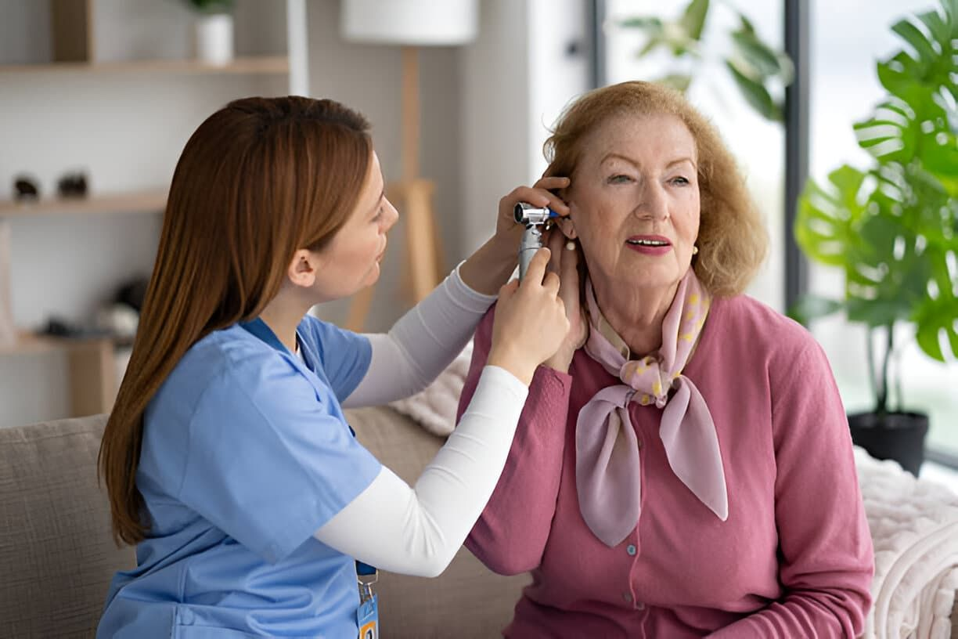
Take Care of Your Vision and Hearing
STATE LOGO
DISTRICT
LOGO

Slide 38
Take Care of Your Vision and Hearing
STATE LOGO
DISTRICT
LOGO
Being able to see and hear well is important for good balance.
Poor vision and hearing loss can increase the risk of falls.

Slide 39
Take Care of Your Vision and Hearing
STATE LOGO
DISTRICT
LOGO
Get an Eye Exam Every Year -
Remember to have a dilated eye exam once a year to update your glasses and to detect eye diseases, like cataracts and glaucoma.
Early detection and treatment can help protect vision and prevent vision loss and falls.

Slide 40

Take Care of Your Vision and Hearing
STATE LOGO
DISTRICT
LOGO
Wear Glasses Properly -
Use prescribed glasses and avoid wearing sunglasses inside.

Slide 41

Take Care of Your Vision and Hearing
STATE LOGO
DISTRICT
LOGO
Be Safe while wearing Bifocals -
Bifocals can make your vision blurry when navigating steps, curbs, or edges, especially while outside.

Slide 42
Take Care of Your Vision and Hearing
STATE LOGO
DISTRICT
LOGO
Be Safe while wearing Bifocals -
If you wear bifocals, tuck your chin in when stepping over curbs and on stairs to look through the distance portion of your glasses, which provides a clearer view.

Slide 43

Take Care of Your Vision and Hearing
STATE LOGO
DISTRICT
LOGO
Check for Hearing Changes -
Get a hearing test once a year.
Receive treatment if any hearing loss is identified.

Slide 44

Take Care of Your Vision and Hearing
STATE LOGO
DISTRICT
LOGO
Light It Up -
Add a nightlight in the bedroom, bathroom, and hallway.
It helps you navigate in the dark and find the light switch.

Slide 45

Make Your Home Safer
STATE LOGO
DISTRICT
LOGO

Slide 46
Make Your Home Safer
STATE LOGO
DISTRICT
LOGO
Thousands of older adults fall at home each year due to common household hazards.
Make sure your home is safe and help prevent falls.

Slide 47

Make Your Home Safer
STATE LOGO
DISTRICT
LOGO
Clear the Way -
Remove tripping hazards, like throw rugs, cords, or clutter on the floor.
Move furniture to create a path for safe movement.

Slide 48

Make Your Home Safer
STATE LOGO
DISTRICT
LOGO
Secure Some Support -
Buy a shower seat, grab bar, and an adjustable-height handheld showerhead to make bathing easier.

Slide 49
Make Your Home Safer
STATE LOGO
DISTRICT
LOGO
Light it Up -
Replace lightbulbs with bright, non-glare bulbs to help you see around the house.

Slide 50
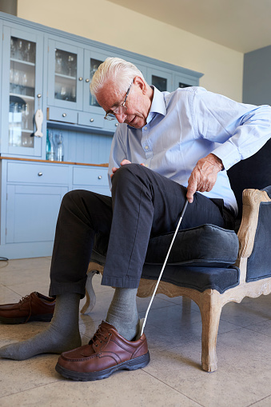
Make Your Home Safer
STATE LOGO
DISTRICT
LOGO
Have a Seat -
Place a chair in your bedroom so you can sit while getting dressed or putting shoes on.

Slide 51

Make Your Home Safer
STATE LOGO
DISTRICT
LOGO
Store for Success.
Keep frequently used items between waist and shoulder height.
It is easier to access without the need for a stepstool or unsafe reaching.

Slide 52

“To care for those who once cared for us is the highest honour”

Slide 53
Ioa Bone & Joint week 2025
3rd to 10th August 2025
Presidential Theme
"Old is Gold : 360° Care for the Elderly”
- Ensuring Mobility, Dignity, and Longevity

